Slide 1
Java Enterprise Edition (JavaEE)
JavaServer Faces Technology
Group 11: Khai, Adrian, Ty

Slide 2
Content
Overall information about JavaServer Faces Technology (JSF)
JSF Life Cycle
Managed Beans
JSF tag
Conclusion

Slide 3
What we know?
Belongs to Web-Tier (Middle-Tier)
Providing framework to simplify the work of developer
Maintaining the data state between user and data server
Based on Model-View-Controller (MVC)

Slide 4
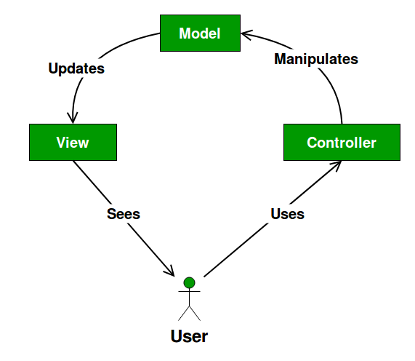

Slide 5
JSF Life Cycle
Restore View ⇒ Create a local component tree
⇒ Connect data with event processing and validation
Apply Request Value ⇒ Parse data from request to local component tree
Validation ⇒ Perform necessary validation
Update Model Values ⇒ Create/Update Data
Invoke Application Handler ⇒ Trigger the event handler
Rendering Response ⇒ Rendering a view to display information
⇒ Save data state and ready to be pushed out

Slide 6
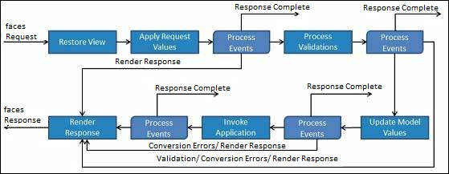

Slide 7
Managed Beans
Regular Java Bean class registered with JSF
Contain getter/setter methods, business logic or backing bean
JSF 1.2 registered via XML
JSF 2.0+ uses annotation to register
Works as Model for UI component
Can be accessed from a JSF page

Slide 8
Managed Bean Annotations
@ManagedBean
@RequestScoped
@NoneScoped
@ViewScoped
@SessionScoped
@ApplicationScoped
@CustomScoped
@ManagedProperty

Slide 9
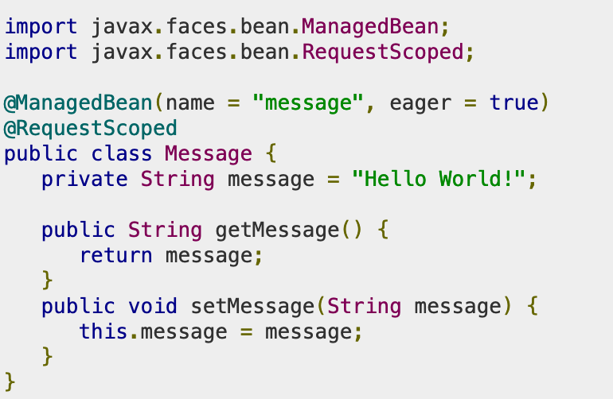
@ManagedBean
Marks bean to be managed
name specified in attribute(default is class name)
eager sets if bean is created before it is requested or on request

Slide 10
@RequestScoped
Lives as long as HTTP request
Created upon HTTP request
Destroyed when HTTP response finished

Slide 11
@NoneScoped
Lives as long as single EL evaluation
Created upon EL evaluation
Destroyed after EL evaluation

Slide 12
@ViewScoped
Lives as long as user is interacting in same view in browser
Created upon HTTP request
Destroyed when user goes to different view

Slide 13
@SessionScoped
Lives as long as HTTP session lives
Created at first HTTP request involving bean
Destroyed when HTTP session invalidated

Slide 14
@ApplicationScoped
Lives as long as the web application lives
Created at first HTTP request involving bean
Destroyed when application shuts down
Also created when eager=true

Slide 15
@CustomScoped
Lives as long as bean’s entry is customly mapped
Configured as java.util.Map
Not commonly used

Slide 16
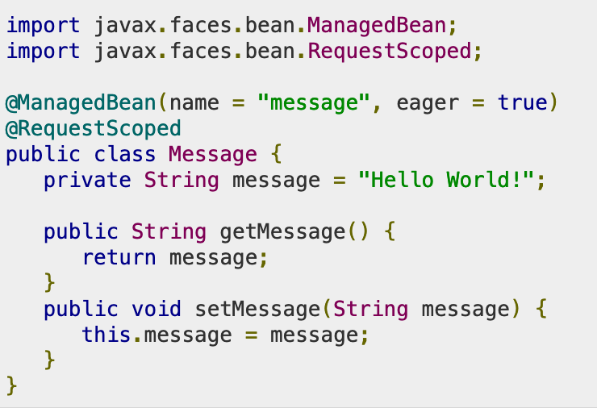
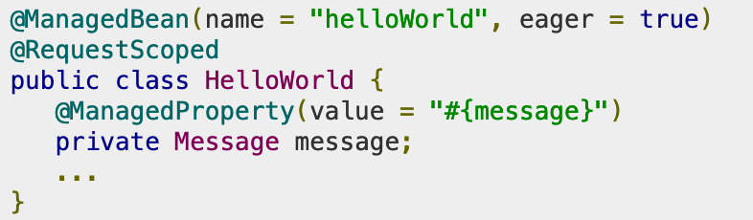
@ManagedProperty
Bean’s property becomes injectable in another Managed Bean

Slide 17
JSF Tag
Basic Tag
Converter
Validator
Facelet Tag

Slide 18
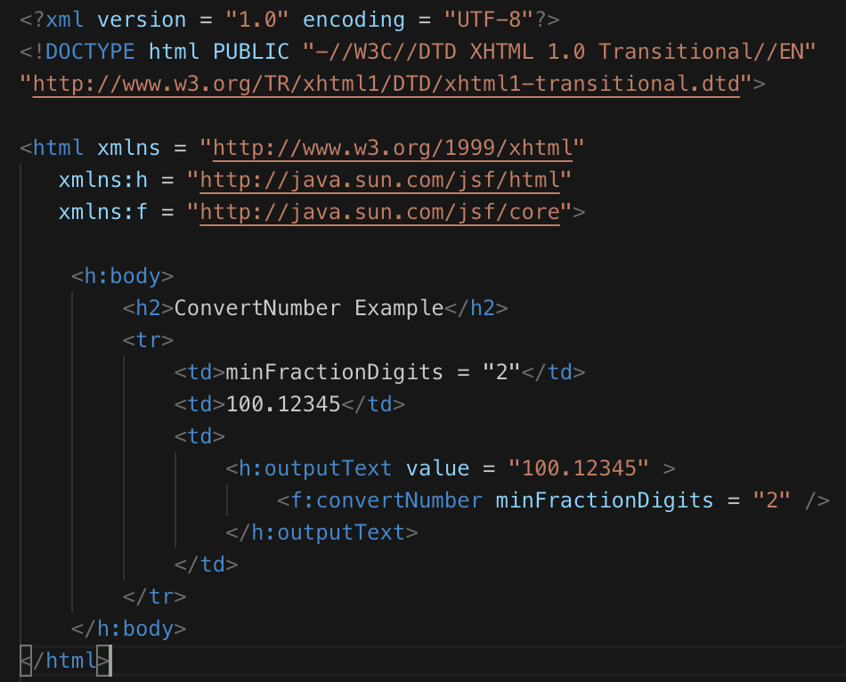
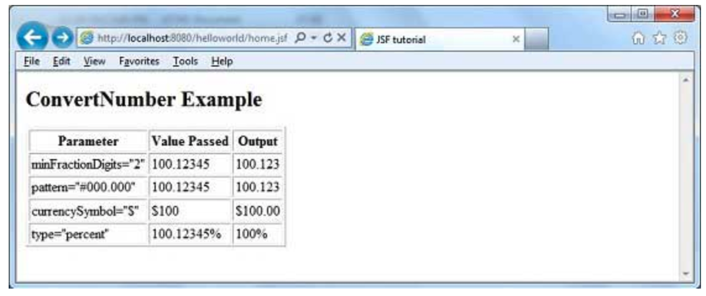
<Converter Tag />
⇐ HEADER
⇐ IMPORT SOURCES

Slide 19
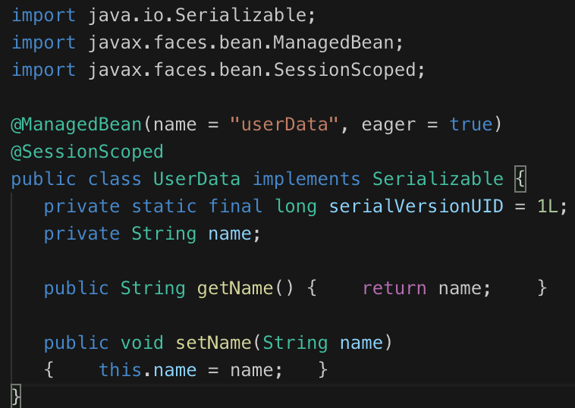
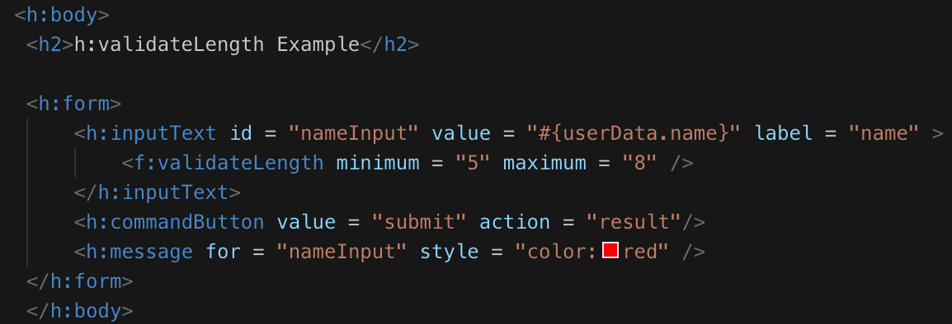
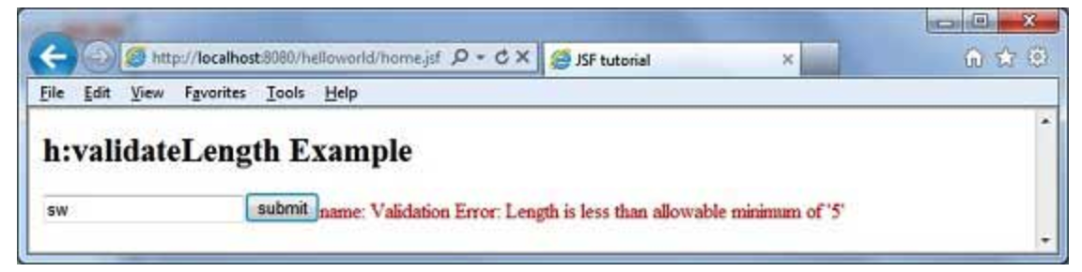
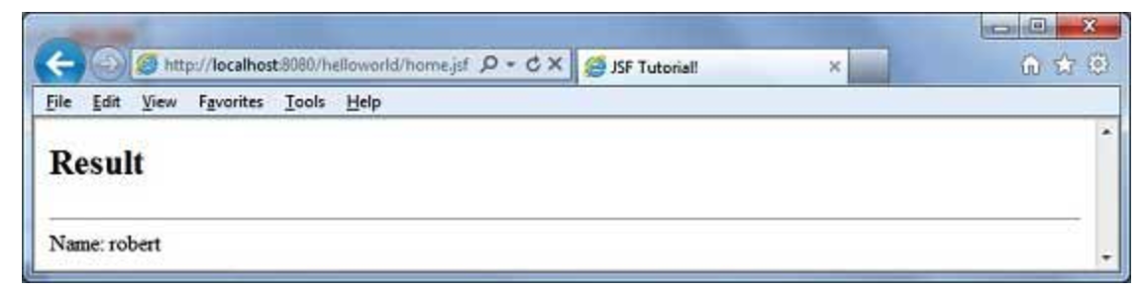
<Validator Tag />

Slide 20
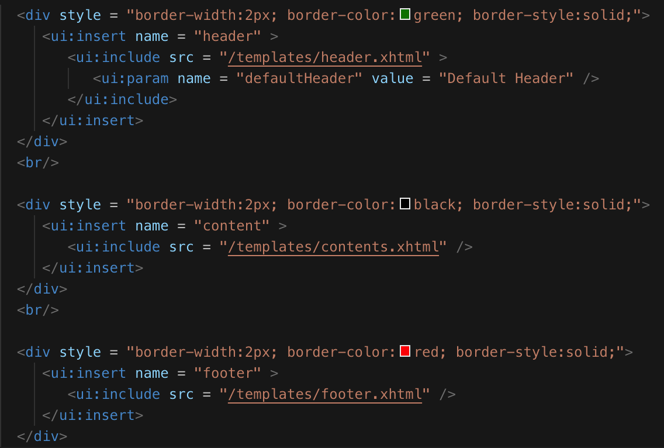
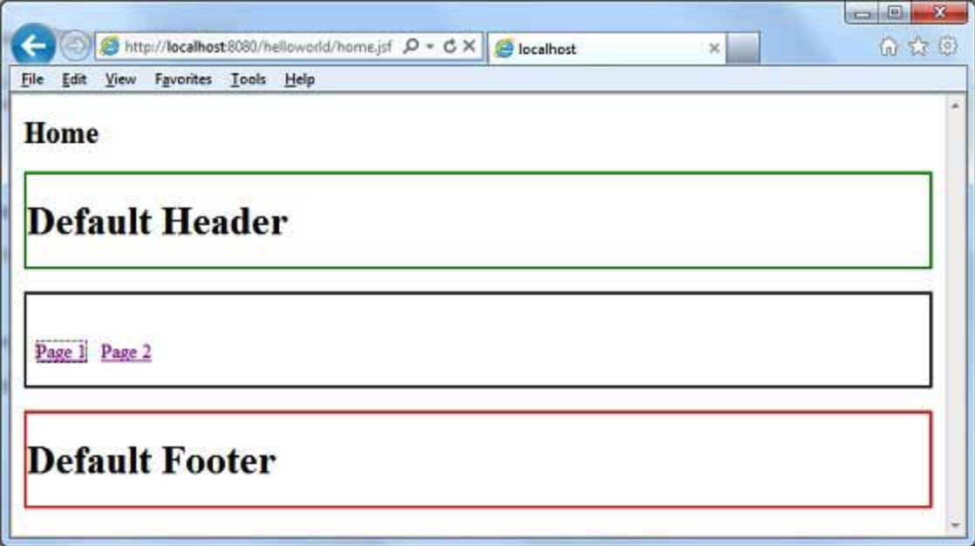
<Facelet Tag />
xmlns:ui = “http://java.sun.com/jsf/facelets”

Slide 21
Why JSF?
Validator, Navigation, and Event Handlers
Helper class in both server side and client side
Different kind of tag use for different purpose
Requires minimal code updates if there are changes made to one side due to MVC (Model-View-Controller) design

Slide 22
Any questions? :)

